Slide 1
LAB 9
Finite State Machine (FSM)
Ui Luu
Glendale Community College
Bassam Matar
Chandler-Gilbert Community College

Slide 2
Learning Objectives
Create a top-level HDL structure
Write VHDL code to describe a Finite State Machine
Apply VHDL codes previously developed in workshop #1 (source codes are provided in this lab template):
(TIMER_DISPLAY.vhd, MEM16.vhd, SECURITY.ucf module) for timer display
Implement INDICATORS.vhd (to provide visual feedback for NEXYS2 on board switches & buttons)
Verify system operations using NEXYS2 evaluation board

Slide 3
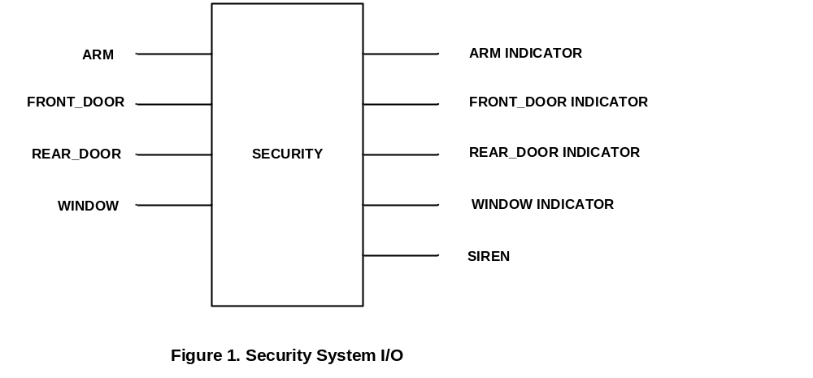
Security Monitor System I/O

Slide 4
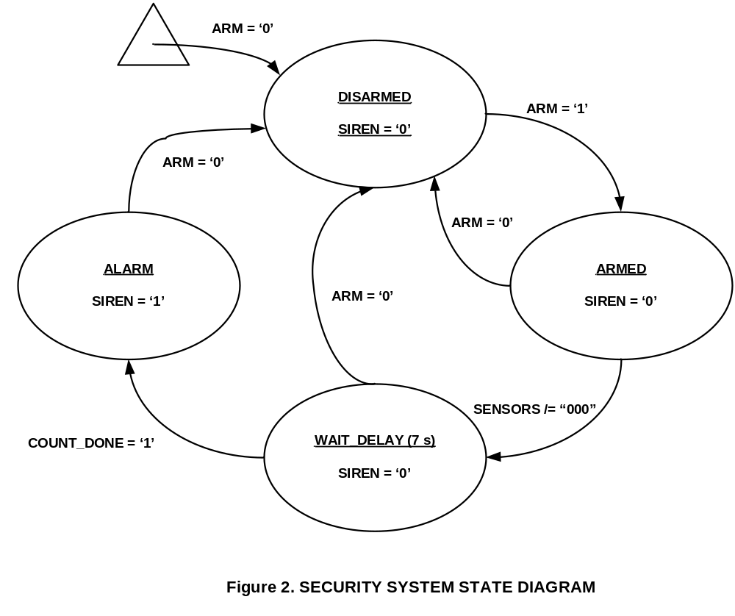
Security System State Diagram

Slide 5
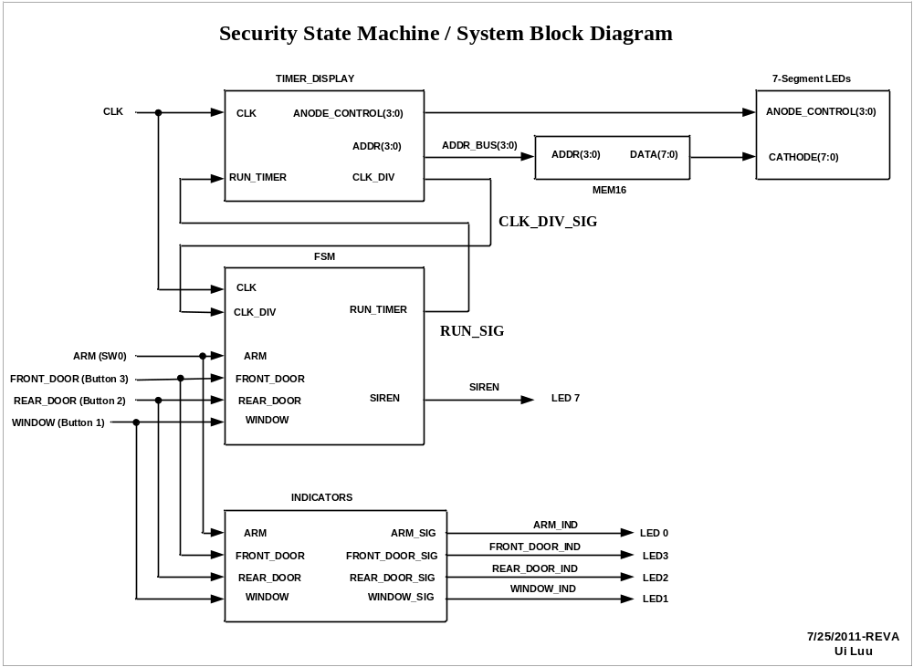
Nexys2 Hardware

Slide 6
TIMER_DISPLAY Module
TIMER_DISPLAY module objectives:
Provides 1 second CLK_DIV signal to Finite State Machine
Provides control signals to display timer using NEXYS2 onboard 7-segment LED display

Slide 7
CLK_DIV signal
Functional Requirement:
Provides 1 second CLK_DIV signal to Finite State Machine
Code Implementation:
process (CLK,REG) begin
if rising_edge(CLK) then
REG <= REG + 1; CLK_DIV_INT<='0';
end if;
if REG = X"2FAF080" then
-- For 1 Hz use X"2FAF080" = 50,000,000 (Decimal)
-- 50 MHz / 50,000,000 = 1 Hz
CLK_DIV_INT<='1';
REG<=X"0000000";
end if;
end process;

Slide 8
TIMER_DISPLAY Functional Description
When RUN_TIMER (from FSM) = 1:
  Timer counts up at 1 second rate
  Display the timer count at 7-Segment LED
When RUN_TIMER = 0:
  Timer resets to 0

Slide 9
TIMER_DISPLAY Implementation
(Note: This implementation was covered in Workshop May,2011)
process (CLK,CLK_DIV_INT,RUN_TIMER)
begin
if RUN_TIMER = '0' then
Q_INT <= (others => '0');
elsif rising_edge(CLK) then
if (CLK_DIV_INT='1') then -- Note: CLK_DIV_INT provides 1-second clock
Q_INT <= Q_INT + '1';
end if;
end if;
end process;
-- Outputs:
ADDR(3 downto 0) <= Q_INT (3 downto 0);
ANODE_CONTROL <= "1110"; -- Enable 1st digit only, active Low
CLK_DIV <=CLK_DIV_INT;

Slide 10
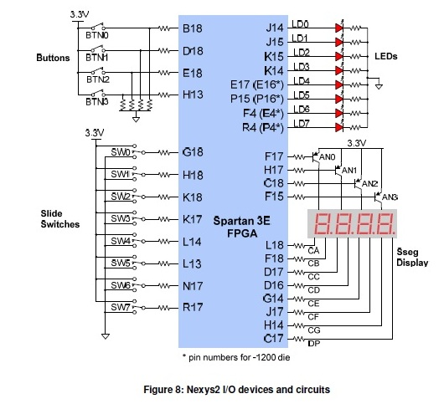
Review NEXYS2 I/O Device
(Ref. Nexys2_m.pdf)

Slide 11
MEM16.vhd
entity MEM16 is
Port ( ADDR : in STD_LOGIC_VECTOR (3 downto 0);
DATA : out STD_LOGIC_VECTOR (7 downto 0));
end MEM16;
architecture Behavioral of MEM16 is
type ROM_ARRAY is array (0 to 15) of std_logic_vector(7 downto 0);
constant MY_ROM :ROM_ARRAY :=(
-- Cathode Control for 7-SEGMENT LED Digit (0-F):
0 => X"03", --0 note: Cathode control is active Low
1 => X"9F", --1
2 => X"25", --2
3 => X"0D", --3
4 => X"99", --4
5 => X"49", --5
6 => X"41", --6
7 => X"1F", --7
8 => X"01", --8
9 => X"09", --9
10 => X"11", --A
11 => X"C1", --B
12 => X"63", --C
13 => X"85", --D
14 => X"61", --E
15 => X"71" --F
);
begin
DATA <= MY_ROM(conv_integer(ADDR));
end Behavioral;

Slide 12
FSM / IO port assignments
(Reference: System Block Diagram)
entity FSM is
Port ( CLK : in STD_LOGIC;
CLK_DIV:in STD_LOGIC;
ARM : in STD_LOGIC;
FRONT_DOOR : in STD_LOGIC;
REAR_DOOR : in STD_LOGIC;
WINDOW : in STD_LOGIC;
RUN_TIMER:out STD_LOGIC;
SIREN : out STD_LOGIC);
end FSM;

Slide 13
Type & Signal names Declarations
type SECURITY_STATE is (ARMED,DISARMED,WAIT_DELAY, ALARM);
signal CURR_STATE,NEXT_STATE: SECURITY_STATE;
signal START_COUNT,COUNT_DONE: std_logic;
signal SENSORS:std_logic_vector (2 downto 0); --combine inputs
signal TIMER_CNTR: std_logic_vector (2 downto 0) := (others => '0');

Slide 14
FSM / Reading Sensors & SYNC Process
SENSORS <= FRONT_DOOR & REAR_DOOR & WINDOW;
SYNC: process (CLK,ARM)
begin
if ARM = '0' then
CURR_STATE <= DISARMED;
elsif rising_edge (CLK) then
CURR_STATE <= NEXT_STATE;
end if;
end process SYNC;

Slide 15
Implement Security System State Diagram (Figure 2)
STATE_MACHINE: process (CURR_STATE,SENSORS,ARM,COUNT_DONE)
begin
START_COUNT <= '0'; -- establish default
case (CURR_STATE) is
when DISARMED =>
if ARM = '1' then
NEXT_STATE <= ARMED;
else NEXT_STATE <= DISARMED;
end if;
-- Output:
SIREN <= '0';
RUN_TIMER <= '0';
when ARMED =>
if (SENSORS /= "000") then
NEXT_STATE <= WAIT_DELAY;
else NEXT_STATE <= ARMED;
end if;
-- Output:
SIREN <= '0';
RUN_TIMER <= '0';
when WAIT_DELAY =>
START_COUNT <= '1';
if (COUNT_DONE = '1') then
NEXT_STATE <= ALARM;
elsif (ARM ='0') then
NEXT_STATE <= DISARMED;
else NEXT_STATE <= WAIT_DELAY;
end if;
-- Output:
SIREN <= '0';
RUN_TIMER <= '1';
when ALARM =>
if (ARM = '0') then
NEXT_STATE <= DISARMED;
else NEXT_STATE <= ALARM;
end if;
-- Output:
SIREN <= '1';
RUN_TIMER <= '0';
end case;
end process STATE_MACHINE;

Slide 16
DELAY_TIMER Process
DELAY_TIMER: process(CLK_DIV,CURR_STATE,START_COUNT,TIMER_CNTR)
begin
COUNT_DONE <= '0'; -- default value
if (rising_edge (CLK_DIV) and (START_COUNT = '1')) then
TIMER_CNTR <= TIMER_CNTR + 1;
end if;
-- *** Note: START_COUNT is set to 1 by the STATE_MACHINE when CURR_STATE = WAIT_DELAY
if (CURR_STATE/=WAIT_DELAY) then -- Note: /= means NOT equal to
TIMER_CNTR <= "000";
end if;
if (TIMER_CNTR = "111") then -- Note: this timer times out at 7 seconds just for convenience
COUNT_DONE <= '1';
end if;
end process DELAY_TIMER;

Slide 17
INDICATORS.vhd
(provides visual feedback for NEXYS2 on board switches & buttons)
entity INDICATORS is
Port ( ARM : in STD_LOGIC;
FRONT_DOOR : in STD_LOGIC;
REAR_DOOR : in STD_LOGIC;
WINDOW : in STD_LOGIC;
ARM_SIG : out STD_LOGIC;
FRONT_DOOR_SIG : out STD_LOGIC;
REAR_DOOR_SIG : out STD_LOGIC;
WINDOW_SIG : out STD_LOGIC);
end INDICATORS;
architecture Behavioral of INDICATORS is
begin
ARM_SIG<=ARM;
FRONT_DOOR_SIG <= FRONT_DOOR;
REAR_DOOR_SIG <= REAR_DOOR;
WINDOW_SIG <= WINDOW;
end Behavioral;

Slide 18
SECURITY.ucf (I/O assignments for NEXYS2-1200)
# SECURITY.ucf
# 7/6/2011: Operation verified with NEXYS2-1200
NET "CLK" LOC = B8;
NET "ARM" LOC = G18; # Switch 0
NET "FRONT_DOOR" LOC = H13; # Button 3
NET "REAR_DOOR" LOC = E18; # Button 2
NET "WINDOW" LOC = D18; # Button 1
NET "ARM_IND" LOC = J14; #LED 0
NET "FRONT_DOOR_IND" LOC = K14; #LED3
NET "REAR_DOOR_IND" LOC = K15; #LED2
NET "WINDOW_IND" LOC = J15; #LED1
NET "CATHODE[0]" LOC = C17; #DP
NET "CATHODE[1]" LOC = H14; #CG
NET "CATHODE[2]" LOC = J17; #CF
NET "CATHODE[3]" LOC = G14; #CE
NET "CATHODE[4]" LOC = D16; #CD
NET "CATHODE[5]" LOC = D17; #CC
NET "CATHODE[6]" LOC = F18; #CB
NET "CATHODE[7]" LOC = L18; #CA
NET "ANODE_CONTROL[0]" LOC = F17;
NET "ANODE_CONTROL[1]" LOC = H17;
NET "ANODE_CONTROL[2]" LOC = C18;
NET "ANODE_CONTROL[3]" LOC = F15;
NET "SIREN" LOC = P4; #LED7 P4 for NEXYS2-1200 (R4 for NEXYS2-500 series)

Slide 19
Hands On Practice
(Work in Team of 2)
Down Load / Copy
“VHDL-SecurityStateMachine-Starter(NEXYS2-1200)” project folder to your desktop
Follow Lab 9 Finite State Machine (FSM) Instructions
Verify the Security State Machine operates as prescribed
Demonstrate to your lab coordinator

Slide 20
Sample Solution
For reference, Sample solution is available at project Folder
“VHDL-SecurityStateMachine-SampleSolution(NEXYS2-1200)”

